Slide 1
Survey of Image Matting
Ehsan Shahrian, Brian Price

Slide 2
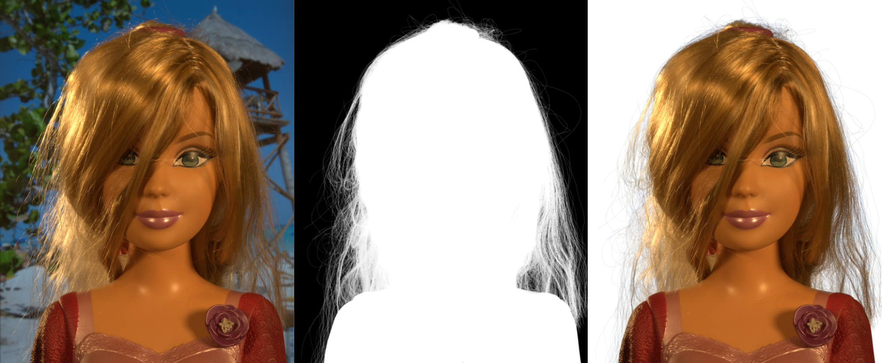
Introduction
- What is image matting ?
Accurate extraction of a foreground object from an image is known as alpha or digital matting
Image
Estimated alpha matte
Extracted foreground
Notes:
What does image matting mean ?
Image matting refers to accurate extraction of foreground object from an image.
As shown in this figure, the doll is precisely extracted from an image using estimated alpha matte.
The main challenge in image matting is how to estimate alpha matte?

Slide 3
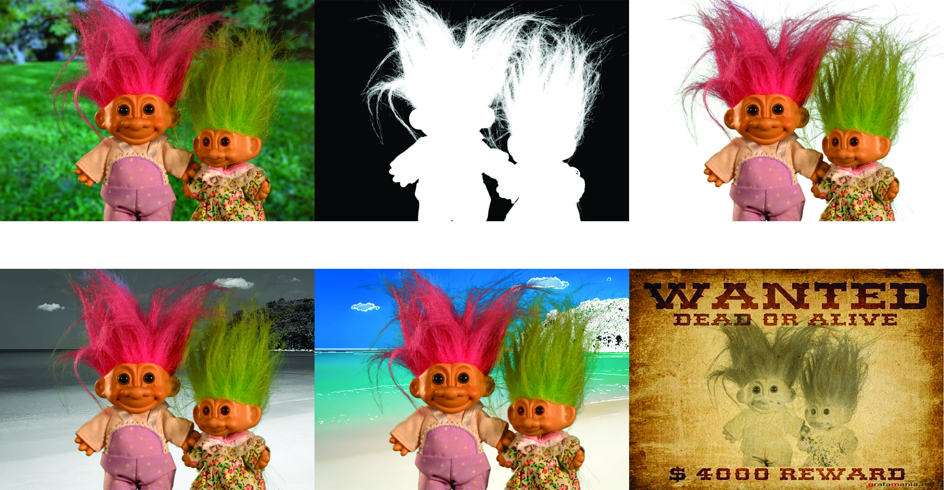
Introduction
- Applications
Image
Estimated Alpha Matte
Extracted Foreground
Composited Image 1
Composited Image 2
Composited Image 3
Notes:
Image matting has different application like image composition , image enhancement and video object cut and paste.
Lets look at some of image matting applications ,
The Estimate alpha matte and extracted foreground object are shown in the first row.

Slide 4
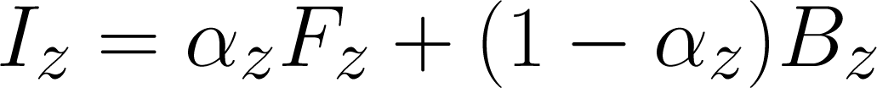
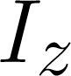
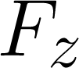
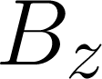
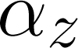
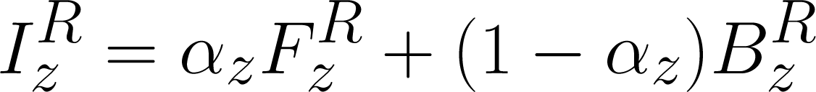
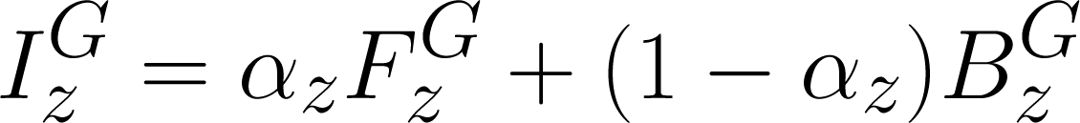
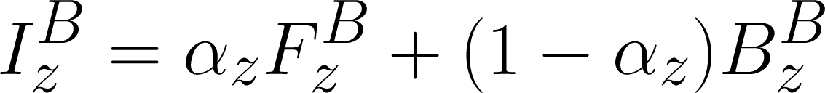
Introduction
- Matting problem definition
Compositing Equation
Observed color of pixel z
Foreground color of pixel z
Background color of pixel z
Alpha value of pixel z

Slide 5

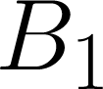
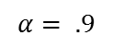
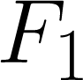
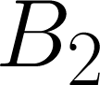
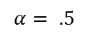
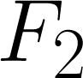
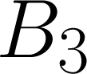
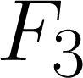
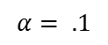
Introduction
- Matting problem definition
Compositing Equation
Observed color of pixel z
Foreground color of pixel z
Background color of pixel z
Alpha value of pixel z

Slide 6
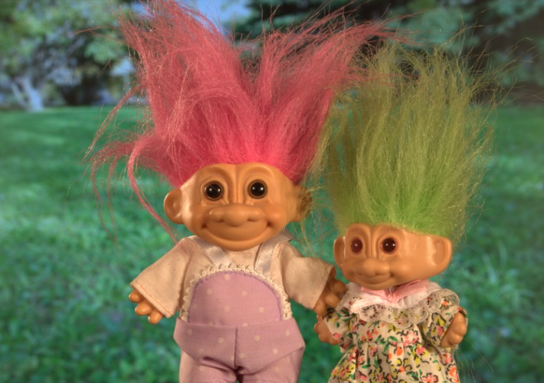
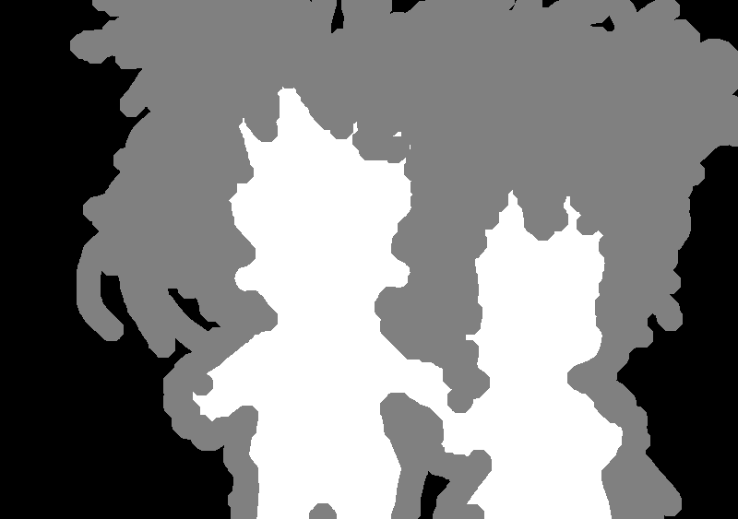
Introduction
- Matting problem definition
How to tackle the ill-posed problem of alpha matting ?
Assumption on image statistics
User constraints like Trimap or scribbles .
Unknown Region
Known Background
Known Foreground
Notes:
The matting methods uses some assumption on image statistics or user contraint like trimap to reduce the solution space.
A shown in the figure , Trimap partition the image into three regions - known foreground, known background and unknown regions that consist of a mixture of foreground (F) and background (B) colors

Slide 7
Introduction
- Image matting methods
Early methods
Model local color distributions parametrically
Alpha is position between the distributions
Notes:
We can categories current alpha matting approaches in to alpha propagation based and color sampling based methods.
In alpha propagation methods, the neighboring pixels are correlated under some image statistics and their affinities are used to gradually propagate alpha from known regions toward unknown region.

Slide 8
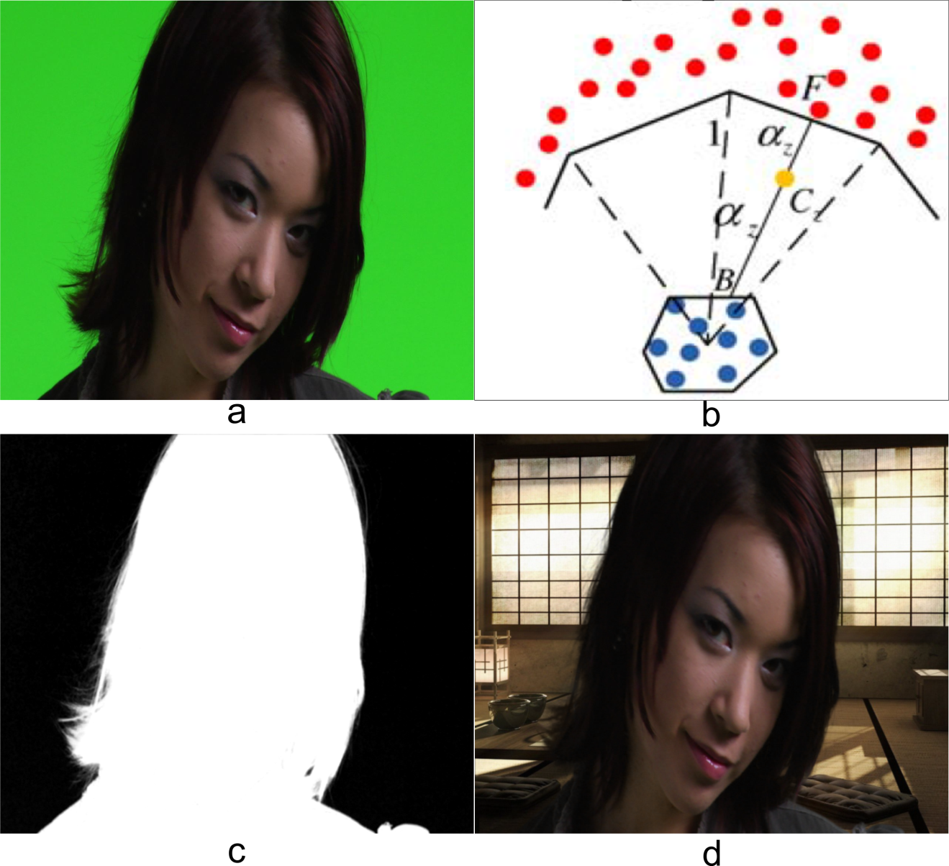
Review of Sampling based methods
- Blue Matting
Y. Mishima, “Soft edge chroma-key generation based upon hexoctahedral color space," 1994. U.S. Patent 5,355,174.
Notes:
In blue screen matting, the foreground object is captured infront of uniform blue or green screen. As shown in the figure .
Since the background has only one color cluster (blue), all background pixels can be covered by a small sphere approximated
by a polyhedra (triangular mesh) in the color space. All foreground pixels form another polyhedra outside the background one.
The alpha value of an unknown pixel is then estimated by calculating its relative position to the two polyhedras..
The blue matting example is shown here.

Slide 9
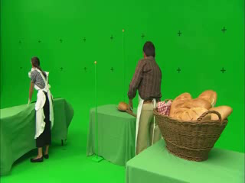
Review of Sampling based methods
- Blue Matting
Notes:
The Green/Blue screen matting plays a fundamental role in film making. The example is shown here.

Slide 10
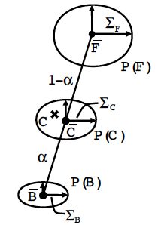
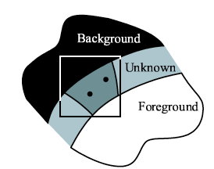
Review of Sampling based methods
- Ruzon-Tomasi method
Ruzon and Tomasi. Alpha Estimation in Natural Images. CVPR 2000.
Notes:
In blue screen matting, the foreground object is captured infront of uniform blue or green screen. As shown in the figure .
Since the background has only one color cluster (blue), all background pixels can be covered by a small sphere approximated
by a polyhedra (triangular mesh) in the color space. All foreground pixels form another polyhedra outside the background one.
The alpha value of an unknown pixel is then estimated by calculating its relative position to the two polyhedras..
The blue matting example is shown here.

Slide 11
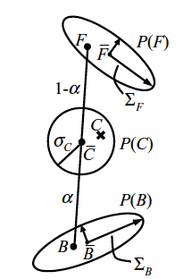
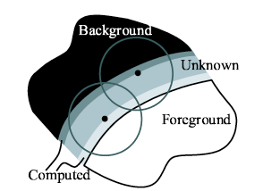
Review of Sampling based methods
- Bayesian matting
Chuang et al. A Bayesian Approach to Digital Matting. CVPR 2001.
Notes:
In blue screen matting, the foreground object is captured infront of uniform blue or green screen. As shown in the figure .
Since the background has only one color cluster (blue), all background pixels can be covered by a small sphere approximated
by a polyhedra (triangular mesh) in the color space. All foreground pixels form another polyhedra outside the background one.
The alpha value of an unknown pixel is then estimated by calculating its relative position to the two polyhedras..
The blue matting example is shown here.

Slide 12
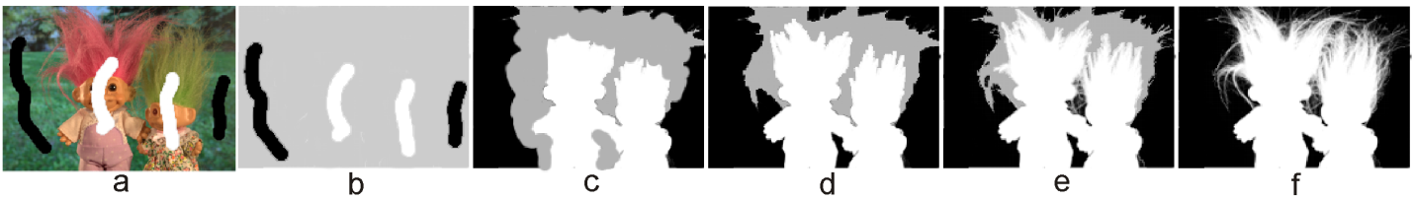
Introduction
- Image matting methods
Alpha propagation based matting methods
Assume that neighboring pixels are correlated under some image statistics and use their affinities to propagate alpha values of known regions toward unknown ones.
[1] A. Levin, D. Lischinski, Y. Weiss, A closed-form solution to natural image matting, IEEE Transactions on Pattern Analysis and Machine Intelligence 30 (2007) 228-242.
[2] P. Lee, Y. Wu, Nonlocal matting, in: IEEE Conference on Computer Vision and Pattern Recognition (CVPR), 2011, pp. 2193-2200.
[3] J. Sun, J. Jia, C. Tang, H. Shum, Poisson matting, ACM Transactions on Graphics (TOG) 23 (2004) 315-321.
[4] L. Grady, T. Schiwietz, S. Aharon, R. Westermann, Random walks for interactive alpha-matting, in Proc. Visualization, Imaging, and Image Processing, 2005, pp. 423-429.
Notes:
We can categories current alpha matting approaches in to alpha propagation based and color sampling based methods.
In alpha propagation methods, the neighboring pixels are correlated under some image statistics and their affinities are used to gradually propagate alpha from known regions toward unknown region.

Slide 13
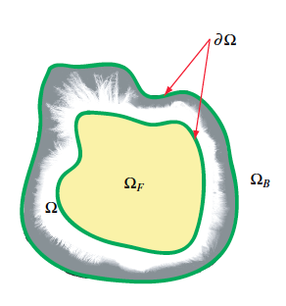
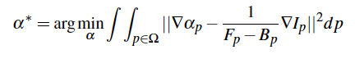
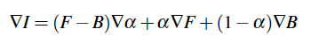
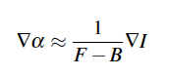
Review of Sampling based methods
- Poisson Matting
Sun et al. Poisson Matting. Siggraph 2004.
Notes:
In blue screen matting, the foreground object is captured infront of uniform blue or green screen. As shown in the figure .
Since the background has only one color cluster (blue), all background pixels can be covered by a small sphere approximated
by a polyhedra (triangular mesh) in the color space. All foreground pixels form another polyhedra outside the background one.
The alpha value of an unknown pixel is then estimated by calculating its relative position to the two polyhedras..
The blue matting example is shown here.

Slide 14
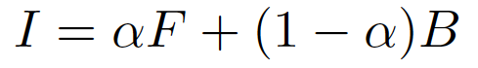
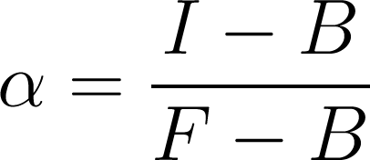
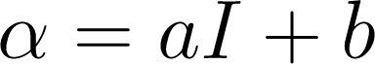
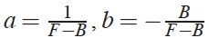
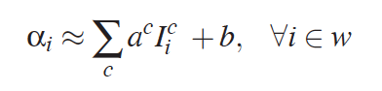
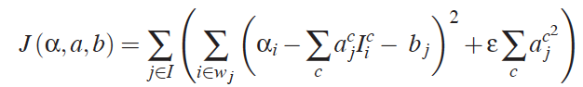
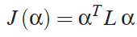
Review of Sampling based methods
- Closed-form Matting
Levin et al. A closed form solution to natural image matting. CVPR 2006.
Notes:
In blue screen matting, the foreground object is captured infront of uniform blue or green screen. As shown in the figure .
Since the background has only one color cluster (blue), all background pixels can be covered by a small sphere approximated
by a polyhedra (triangular mesh) in the color space. All foreground pixels form another polyhedra outside the background one.
The alpha value of an unknown pixel is then estimated by calculating its relative position to the two polyhedras..
The blue matting example is shown here.

Slide 15
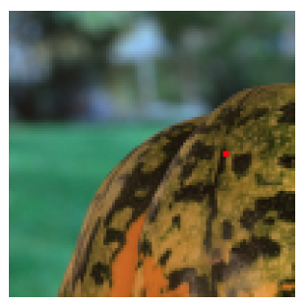
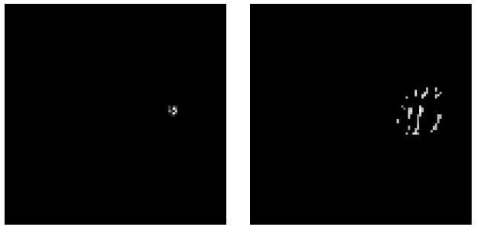
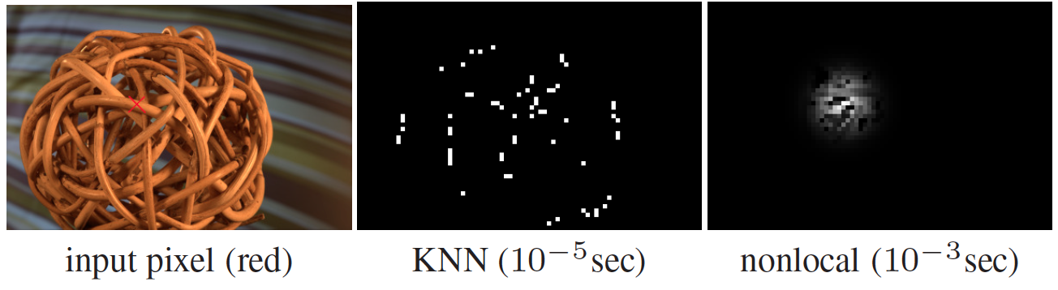
Review of Sampling based methods
- Nonlocal neighborhoods
Lee and Wu. Nonlocal matting. CVPR 2011.
Chen et al. KNN matting. CVPR 2012.
Notes:
In blue screen matting, the foreground object is captured infront of uniform blue or green screen. As shown in the figure .
Since the background has only one color cluster (blue), all background pixels can be covered by a small sphere approximated
by a polyhedra (triangular mesh) in the color space. All foreground pixels form another polyhedra outside the background one.
The alpha value of an unknown pixel is then estimated by calculating its relative position to the two polyhedras..
The blue matting example is shown here.

Slide 16
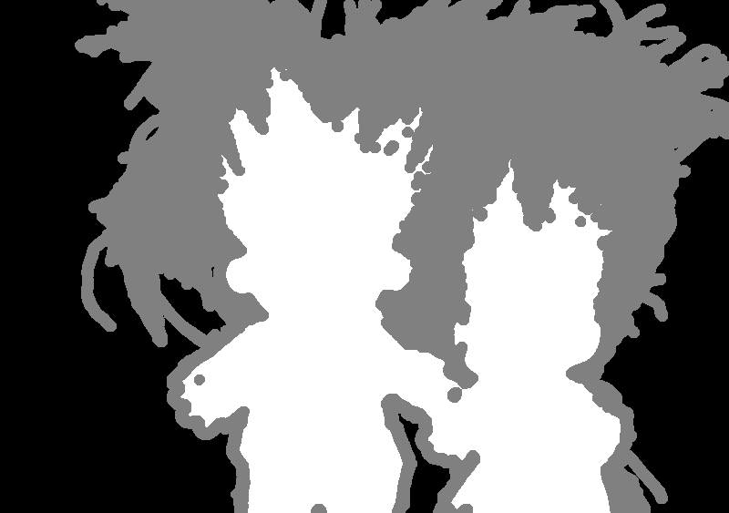
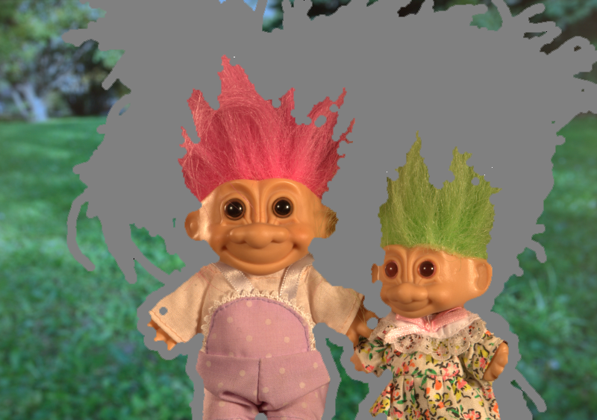

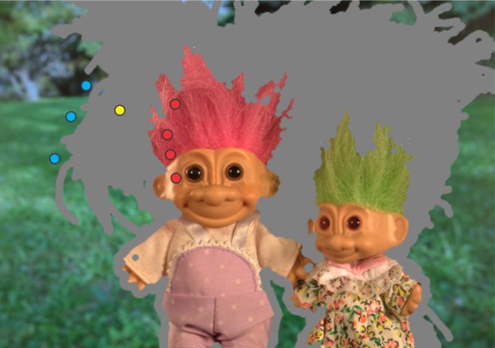
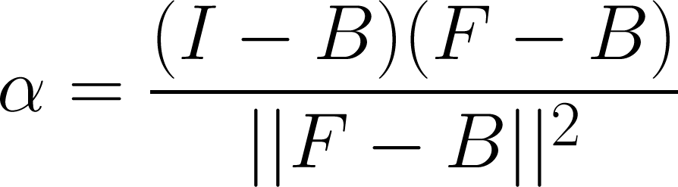
Introduction
- Image matting methods
Sampling based matting methods
Color sampling based methods collect a set of known foreground and background samples to estimate alpha values of unknown pixels.
Sets of known Foreground and Background samples
Set of (F,B) pairs
Notes:
Color sampling based methods collect a set of known foreground and background samples to estimate alpha values of unknown pixels. Different combinations of spatial, photometric and probabilistic characteristics of an image are used to find the best known samples that best represent the true foreground and background colors of unknown pixels. Once the best known foreground and background
Samples are selected for pixel z, its alpha value can be computed using presented equation.
The main questions here are
How many samples should be collected?
How to find the best F,B pairs ?
Lets look at some of sampling strategies of different sampling methods.

Slide 17
Introduction
- Image matting methods
Common steps
Collect samples
Choose the best F/B pair
Refine alpha
Notes:
Color sampling based methods collect a set of known foreground and background samples to estimate alpha values of unknown pixels. Different combinations of spatial, photometric and probabilistic characteristics of an image are used to find the best known samples that best represent the true foreground and background colors of unknown pixels. Once the best known foreground and background
Samples are selected for pixel z, its alpha value can be computed using presented equation.
The main questions here are
How many samples should be collected?
How to find the best F,B pairs ?
Lets look at some of sampling strategies of different sampling methods.

Slide 18
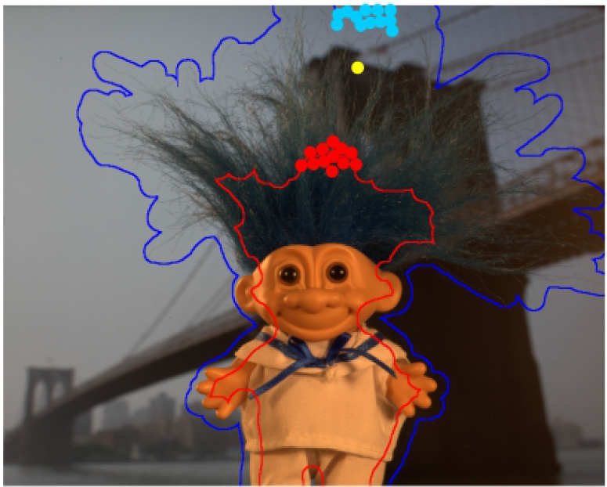
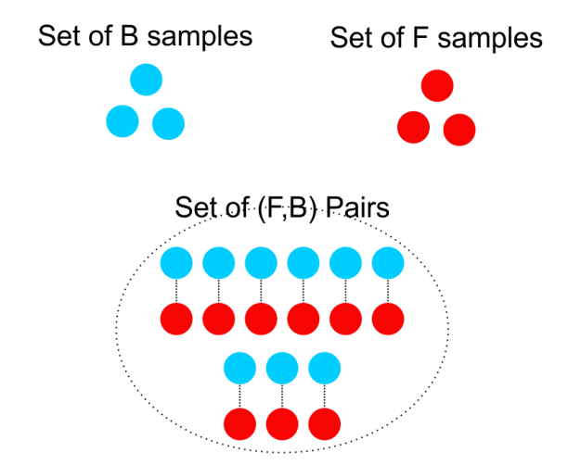
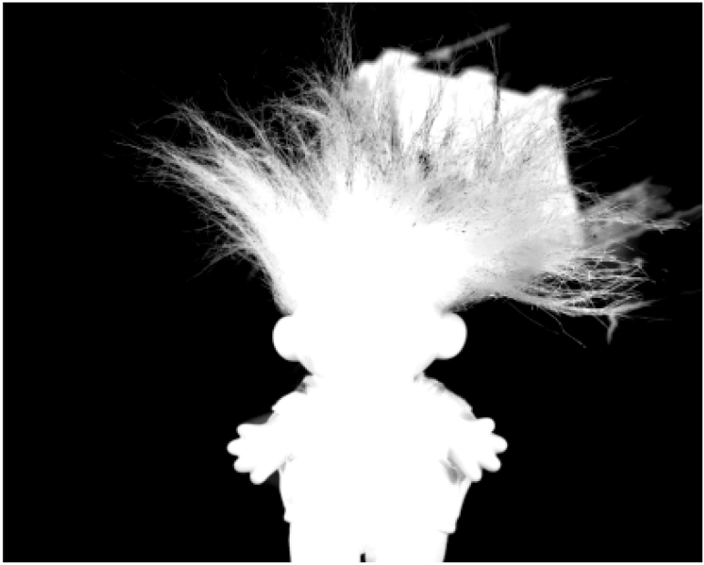
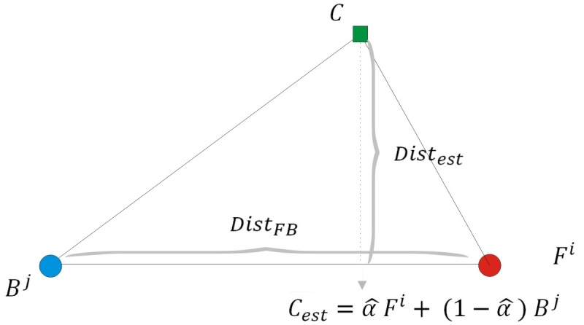

Review of Sampling based methods
- Robust Matting
J. Wang and M. Cohen, “Optimized color sampling for robust matting," in IEEE Conference on Computer Vision and Pattern Recognition (CVPR), pp. 1-8, 2007.
Notes:
Wang et al.[3], proposed an optimized color sampling procedure to select F and B samples that best represent true foreground and background colors of unknown pixels as a convex
combination of their colors. Therefore set of spatially close known F and B samples are collected to build a set of (F;B) pairs for unknown samples as shown in with blue and red.
The Set of selected foreground and background samples are paired together to build set of (F,B) pair for every unknown pixel.
The best (F;B) samples are selected by optimizing an objective function which uses distance ratio. Distance ratio is a ratio between color tness and the distance between
foreground and background colors of (F;B) pair.
The numerator shows the distance between observed color and estimated color.
The denominator indicates the distance between F and B samples in the color space as shwon here with Dist_FB.
The (F;B) pairs with small distance ratio are more likely candidates compared to those with large distance ratio. The distance ratio is inversely proportional to distance between
foreground and background of (F;B) pair in color space, thus it tends to select sample pairs which are widely spread in color space. This problem is solved by ranking the
(F;B) pairs based on color distance of their foreground and background components to the color of the unknown pixel. The confidence of (F;B) pair for each pixel is computed based on distance ratio and rank of sample pair among all other pairs.

Slide 19

Review of Sampling based methods
- Improved Color Matting
Robust Matting : J. Wang and M. Cohen, “Optimized color sampling for robust matting," CVPR 2007.
Improved Color : C. Rhemann, C. Rother, and M. Gelautz, “Improving color modeling for alpha matting," in Proc. British Machine Vision Conference, 2009.
Notes:
The Euclidean distance is used by Robust matting to collect spatially close samples while the geodesic distance
is used by improved color matting [] to collect samples with similar color to unknown pixel as shown in figure.
the overlapped colors distributions of F and B regions make it hard for color sampling based matting methods to estimate alpha reliably
thus Bridge's tower is wrongly estimated as foreground by Robust and Improved color matting methods as shown in second row

Slide 20

Review of Sampling based methods
- Shared Matting
Sample Gathering Stage :
The red arrows starting at p define the paths for searching for background and foreground samples for p. The selected (closest) samples are marked in orange. Pixel q explores a different path (in blue). Foreground samples are shown as squares, and background samples as circles.
E. Gastal and M. Oliveira, “Shared sampling for real time alpha matting," in Proc. Eurographics , 2010, vol. 29, pp. 575-584, 2010.
Notes:
The redundant computation of sampling for every unknown pixel can be eliminated by sharing samples and distributing the work among neighboring pixels because neighboring pixels present highly similar values for ( alpha; F;B) triplet. This key observation is used by Shared matting [2] and the samples selection task is divided among various neighboring pixels in the sample gathering stage.
The results are shared and refiened in the second stage (sample refinement stage).
Sample gathering Stage : for each unknown pixel, a small set of known samples are gathered to guarantee that the sample sets of neighboring pixels are disjoint.
For this purpose the image plane is divided into sectors with equal angles and a set of known samples that lie along rays emanating from the unknown pixel are collected as shown in Figure

Slide 21





Review of Sampling based methods
- Shared Matting
Compatibility with F
Color Fitness
Spatial Energy
Notes:
It selects samples from the boundaries of known foreground and background regions as specified by the trimap and selects the best samples with respect to spatial, photometric and probabilistic characteristics of the
image as follows :
where z is set of collected (F;B) pairs for unknown pixel z.
N_z(F,B) is color fitness which minimizes chromatic distortion in the 3x3 neighborhood around z.
A_z(F,B) is used to enforces computed alpha matte values to correlate with the probability of pixel z belonging to the foreground.
The spatial affinity is enforced by Dz(Fi) and Dz(Bj) to select closest known foreground and background samples to z.
The contribution of the terms are practically weighted by e_N =3 , e_A =2, e_f=1, e_b=4.

Slide 22


Review of Sampling based methods
- Shared Matting
Sample Refinement Stage
Notes:
Once the best (F;B) pair is selected for unknown pixels, a more extensive search is performed in sample refinement stage by sharing the results of neighboring pixels to get better estimation of (; F;B) for unknown pixels.
each pixel p compares its own choice of best sample-pair with the choices of its (at most) kr spatially closest pixels q ∈ Tu. Among those,
the three tuples (\alpha , F, B) with the lowest values of Mp are then averaged to create a new tuple (\alpha, F, B , f).
In which the f is confidence of estimation.
The conventional laplacian refinement proposed by closed form is updated and used here.
Lets look at some of the examples.

Slide 23

Review of Sampling based methods
- Shared Matting
Notes:
Some example of shared matting is shown here.
The quality of estimated mattes are good when F and B regions are distincts.
The quality of estimated mattes degrades when F and B regions have similar colors because color feature fails to discriminate between F and B.

Slide 24


Review of Sampling based methods
- Global Matting
K. He, C. Rhemann, C. Rother, X. Tang, and J. Sun, “A global sampling method for alpha matting," in IEEE Conference on Computer Vision and Pattern Recognition (CVPR), pp. 2049-2056, 2011.
Notes:
A large sets of foreground and background samples are build in Global Sampling Matting by collecting all known boundary samples to avoid missing true samples as shown
in Figure. The best samples among a huge number of known samples are selected using an efficient random search and a simple cost function.
The cost function takes advantages of the color fitness term that show how good a sample pair fits the compositing equation and spatial cost term that favors spatially close samples, to find best (F;B)

Slide 25




Review of Sampling based methods
- Global Matting
Spatial Energy
Color Fitness
Notes:
The cost function takes advantages of the color fitness term that show how good a sample pair fits the compositing equation and spatial cost term that favors spatially close samples, to find best (F;B).
Once the best (F;B) pair is selected among huge number of the pairs using an ecient random search for unknown pixels then the matte is estimated.
Finally two different post-processing of guided filters and Laplacian refinement of closed form are used to smooth the matte.
Here is some of the results

Slide 26

Review of Sampling based methods
- Global Matting
Notes:
Here is the result on global matting on some benchmark images.
However the large number of samples is collected but still some part of book title is considered as foreground matte.

Slide 27
Content
Introduction
Review of Color Sampling based methods
Image Matting using Texture and Color features
Selection of Comprehensive set of Samples
Conclusion
Future work

Slide 28

Problem of Color Sampling methods
- Overlapping of F and B color distributions
The color sampling based matting method fails to extract the alpha mattes properly when F and B regions have similar color distributions. This is called Overlapping of F and B color distributions.
.
Notes:
The quality of estimated mattes by sampling based methods degerades when F and B regions have similar colors or overlapped color distributions. Because color feature fails to discriminate between F and B region. This problem is known as Overlapping of F and B color distributions.

Slide 29
Image Matting using Texture and Color
Using Texture to Complement Color in Image Matting
late combination of color and texture
Weighted color and texture sample selection for image matting
Early combination of color and texture
Notes:
When The F and B with similar colors may have different textures. This ideas is used in this thesis and two different matting methods are proposed to discriminated between F and B regions when they have similar colors.
The texture feature can be combined with color feature at different stages of the matting process. The first proposed method uses a late combination of color and texture.
An initial matte is estimated using only texture information and then it is used to improve the color matte.
The second proposed method combines color and texture in the early stages of matting and uses both color and texture in matting process to improve matting.

Slide 30




Using Texture to Complement Color
- Overview
Texture extraction
Texture Matting
Texture matte
Texture Feature
Color and Texture
Matting
Color Image
Final Matte

Slide 31


Using Texture to Complement Color
- Texture extraction
Chromatic content
Notes:
Texture feature is generated from chromatic and structural content in an image.
Texture properties are considered over an image patch in which the chromatic information is as homogeneous as possible and only the dominant color in the patch is retained.
To this end, we smooth the image using bilateral filters. And combined them to generate Ismooth.
Latter The Ismooth and difference of Original Image and biateral filtered one are used to build the choromatic information of texture as shown in the figure.
% --------------------------------------------------------------------------------------------------------------------
, we need to ensure that strong edges that participate in the texture do not get smoothed inadvertently. Hence, the first step is the application of a set of three edge-preserving bilateral filters to obtain high, medium and low smoothing.
W0 indicates how much information is taken from the input and bilateral filtered images with respect to absolute differences between them.
The structural content of the texture is obtained through a Haar wavelet decomposition of the image into 4 sub-images called Approximation (IA), Horizontal (IH), Vertical (IV ) and Diagonal (ID) details. Each of the sub images is resized to that of the original image and the mean of the coefficients over a neighborhood of size 3 3 is computed for each pixel. Similarly, the variance of the coefficients over a similar neighborhood is
calculated along four directions - horizontal, vertical, major and minor diagonals. Thus the structural component of the texture feature vector for a pixel is

Slide 32



Using Texture to Complement Color
- Texture extraction
Structural content
Raw 32 Dimensional Texture Feature
Two Level
Dimension Reduction
(PCA + LDA)
Notes:
The structural content of the texture is obtained through a Haar wavelet decomposition of the image into 4 sub-images called Approximation (IA), Horizontal (IH), Vertical (IV ) and Diagonal (ID) details.
Each of the sub images is resized to that of the original image and the mean of the coefficients over a neighborhood of size 3 3 is computed for each pixel. Similarly, the variance of the coefficients over a similar neighborhood is
calculated along four directions - horizontal, vertical, major and minor diagonals. Thus the structural component of the texture feature vector for a pixel is
The two level dimension reduction is applied to reduce the dimensions to three and increase the distinction between F and B regions using texture information.

Slide 33

Using Texture to Complement Color
- Texture extraction
Original Image
Red Histogram
Green Histogram
Blue Histogram
Texture Image
Texture Histogram

Slide 34

Using Texture to Complement Color
- Sample selection
Notes:
The sampling strategy is similar as sampling strategy of shared matting method.
The different is that the sampling is done in block resolution.
The input image is divided into blocks and a mixture of Gaussian distributions is assigned to each block to model its color distribution.
A set of color models for unknown blocks are constructed by choosing models from some known blocks.
This process is illustrated here
As you can see, for unknown yellow block, 8 line segments are drawn at angular increments of 45 degree .
These line segments choose the model of the first known block that they encounter.
Here three known foreground and three known background blocks are selected.
Each GMM component in a model is then sampled individually and the generated samples are paired together construct a set of foreground-background (F;B)
%-----------------------------------------------
For each unknown block, m line segments are drawn at angular increments of 2Pi /m with the first line segment having an orientation of 0 These line segments choose the model of the first known block that they encounter.
In our experiment the m is 20.
Each component in a model is then sampled individually and the generated samples are paired together construct a set of foreground-background (F;B) pairs. Such a sampling ensures that (F;B) pairs are obtained for every block so that samples are generated even for small clusters, which might be missed if random sampling were employed.

Slide 35







Using Texture to Complement Color
- Best (F,B) pair selection
Chromatic distortion
Distinction of F and B Distributions
Spatial energy
the spatial cost required for F_{i} to reach the pixel z
the spatial cost required for$F_{i}$ to reach the pixel $z$
Notes:
The proposed objective function uses chromatic distortion and spatial and color statistics to find the best (F,B) pair for every unknown pixels.
The linear model of compositing equation successfully explains the color of a pixel as a convex combination when the estimated color is close to its observed color. The D term is defined to show the chromatic distortion.
E term involves the distance between an (F;B) pair and the unknown pixel at block resolution in the spatial domain. It shows the required spatial energy fot F,B pair to reach the unknown pixel.
S term is defined with respect to problem of the overlapping of foreground and background distributions. It is biased towards those (F;B) pairs that come from well separated distributions. Which is computed based on Cohen's value. Cohen's d value is inversely proportional to the overlap of distributions.

Slide 36


Using Texture to Complement Color
- Overview
Texture extraction
Texture Matting
Texture matte
Texture Feature
Color and Texture
Matting
Color Image
Final Matte
Notes:
T term here indicates the compatibility of estimated alpha using color and texture information.
The Laplacian refinement is used as a post processing to refine the final matte

Slide 37


Using Texture to Complement Color
- Texture and color combination effect
Effect of combining color and texture matte to obtain improved alpha matte. (a) Original image, (b) Visualization of first dimension of extracted texture features, (c) Estimated matte using only texture features, (d) Estimated mattes using only color features, (e) Estimated mattes using texture and color features by proposed method.

Slide 38

Using Texture to Complement Color
- Benchmark database
Evaluation Measures :
sum of absolute differences(SAD)
mean squared error (MSE)
C. Rhemann, C. Rother, J. Wang, M. Gelautz, P. Kohli, and P. Rott, “A perceptually motivated online benchmark for image matting," in IEEE Conference on Computer Vision and Pattern Recognition (CVPR), pp. 1826-1833, 2009.
Notes:
The test set comprises of 8 images for which the ground truth alpha mattes are hidden from the public and for every test image three different trimaps are presented as small , large (coarse) and user defined trimaps .
The sum of absolute differences (SAD)
and the mean squared error (MSE) are used to evaluate the results.

Slide 39


Using Texture to Complement Color
- Experimental results

Slide 40


Using Texture to Complement Color
- Experimental results

Slide 41

Using Texture to Complement Color
- Experimental results

Slide 42

Using Texture to Complement Color
- Synthetic database
Notes:
In order to show the effectiveness of the proposed combined matting method for highly textured images.
a new set of 15 images (some of images are taken from the training set proposed by [1]) is synthesized in such a way that
foreground and background have similar color distributions .

Slide 43


Using Texture to Complement Color
- Experimental results

Slide 44

Using Texture to Complement Color
- Experimental results
Quantitative evaluations of Shared, Robust, Closed-form and Combined matting methods for synthesized images with (a) Small, (b) Large and trimaps with respect to MSE .

Slide 45
Weighted Color and Texture Matting
Matting Application
Image Matting using Texture and Color features
Using Texture to complement color in Image Matting
Weighted Color and Texture sample selection for image matting
Selection of Comprehensive set of Samples
Image Matting using Comprehensive Sample Sets
Improved Weighted Color and Texture Matting Using Local and Global Sampling
Video Matting
Conclusion
Papers
Acknowledgment

Slide 46
Weighted Color and Texture Matting
-Overview
Texture Feature
Texture extraction
Weighted
Color and Texture
Matting
Color Image
Final Matte
46
Notes:
Thw weighted color and texture matting uses a simillar sampling approach as previous method.

Slide 47





Weighted Color and Texture Matting
-Texture Feature
Troll Image
Wavelet Decomposition
Texture Feature
Two Level
Dimension Reduction
(PCA + LDA)

Slide 48




Weighted Color and Texture Matting
- Selection of best (F,B) pair
Notes:
C_alpha : measures the color fitness by considering the compatibility of the linear model of compositing equation with convex combination of foreground and background component.
T_alpha : indicates the compatibility of estimated \alpha using color information with similarity of pixel to foreground or background in texture space.

Slide 49











Weighted Color and Texture Matting
- Color and Texture contributions
$$e_{C} ↓$$
$$e_{T} ↑$$
$$e_{C} ↑$$
$$e_{T} ↓$$
B
F
Notes:
The contribution of color and texture components are weighted using e_c and e_T .
when there is signicant overlap in color, texture is considered more reliable. However, when the color distributions are distinct, then it is more reliable that texture.
The degree of overlap between two distribution is computed using OL.
The overlap computation is carried out for set of candidate (F,B) pairs and is independent of number of F, B samples.
When color F and B distributions overlap completely and corresponding texture distributions are completely separated, ec = e= e^-1 and et = 1.
In the converse case, ec = 1 and et = e^-2. Note that texture by itself may not be very reliable since it is computed at block resolution.

Slide 50
Weighted Color and Texture Matting
- Color and Texture contributions
$$e_{C} ↓$$
$$e_{T} ↑$$
B
F
Notes:
The contribution of color and texture components are weighted using e_c and e_T .
when there is signicant overlap in color, texture is considered more reliable. However, when the color distributions are distinct, then it is more reliable that texture.
The degree of overlap between two distribution is computed using OL.
The overlap computation is carried out for set of candidate (F,B) pairs and is independent of number of F, B samples.
When color F and B distributions overlap completely and corresponding texture distributions are completely separated, ec = e= e^-1 and et = 1.
In the converse case, ec = 1 and et = e^-2. Note that texture by itself may not be very reliable since it is computed at block resolution.

Slide 51



Weighted Color and Texture Matting
-Texture Feature
Image
Raw Matte
Laplacian refined
Iterative refined
Laplacian Refinement
Iterative refinement
E. Gastal and M. Oliveira, “Shared sampling for real time alpha matting," , Eurographics 2010.
Notes:
The raw matte is refined using laplacian refinement
Or by using similar neighboring samples. The contribution of neighboring samples is weighted based on their color and texture similarity.

Slide 52


Weighted Color and Texture Matting
-Texture Feature

Slide 53

Weighted Color and Texture Matting
-Texture Feature
Visual comparison between various methods. (a) Original image (b) Zoomed-in portion (c) Robust (d) Shared (e) Bayesian (f) Closed-form and (g) proposed method with Laplacian post-processing.

Slide 54

Weighted Color and Texture Matting
-Texture Feature
Visual comparison between matting methods on new data set

Slide 55

Weighted Color and Texture Matting
-Texture Feature
MSE of different matting methods for new set of images with small and large trimaps.

Slide 56
Content
Introduction
Image Matting using Texture and Color features
Comprehensive set of Samples
Video Matting
Conclusion
Papers
Acknowledgment

Slide 57

Comprehensive set of Samples
- Problem discussion
Missing True Samples Problem
Notes:
The quality of the extracted mattes by sampling based methods is highly dependent on the selected samples. It degrades when the true foreground and background colors of unknown pixels are not in the sample sets. We call this the missing true samples problem.
Lets look at different sampling strategies.
The robust matting method collects a few samples that are spatially close to unknown pixel as shown in the Figure (c).
The Shared matting divides the image plane into disjoint sectors containing equal planar angles by emanating the rays from unknown pixels as shown in the figure.
It collects boundary Foreground and background samples that lie along these rays. The set of F,B pair cover more color variations in compare of selected samples by robust matting.. if the desired sample for unknown pixels does not lie on the boundary, the extracted matte will not be accurate.
The largest set of known samples, among all other sampling based approaches, are built by collecting all known boundary samples in Global matting as shown in the Figure. A simple cost function and an efficient random search are used to find the best samples among a huge number of known samples for every unknown pixel. The true samples may still be missed if they are not on the boundary of the known regions.
The estimated mattes by robust, shared and global matting method are still inaccurate because foreground black color samples are inside the region and are excluded from the set of collected samples.
% -------------------------------------------------------------------------------------------------------------------------------------------------------------------------------------------------------------------------------------------------------------------------------
The new method is proposed which Collects highly correlated boundary samples as well as samples inside of the F and B regions.
To build comprehensive set of F,B pair to avoid missing true samples problem. It Uses new objective function to find the best (F,B) pair.
The quality of the extracted matte is highly dependent on the selected samples. It degrades when the true foreground and background colors of unknown pixels are not in the sample sets. We call this the missing true samples problem.
The range in which the foreground and background are sampled is often limited to such an extent that the true foreground and background colors are not present.
1. Robust matting collects a few samples that are spatially close to the unknown pixel as shown in the first row of Fig. 1(c) in which the unknown pixel is shown in yellow and the foreground and background samples are shown in red and blue, respectively.
The selection of best known background and foreground samples from the candidate set
is done with respect to a color fitness parameter. The quality of estimated mattes degrades when the true samples are not in the sets of known samples.
2. Shared matting divides the image plane into disjoint sectors containing equal planar angles and collect samples that lie along rays that are emanated from unknown pixels as shown in the first row of Fig. 1.(d). It collects these samples from the boundaries of foreground and background regions as specified by a trimap. Different combinations of spatial, photometric and probabilistic characteristics of the image are used to find best samples for unknown pixels. if the desired sample for unknown pixels does not lie on the boundary, the extracted matte will not be accurate.
3. In order to avoid missing true samples, the largest set of known samples, among all other sampling based approaches, are built by collecting all known boundary samples in Global matting as shown in the first row of Fig. 1(e). A simple cost function and an efficient random search are used to find the best samples among a huge number of known samples for every unknown pixel. Finally, the estimated alpha matte is refined by solving a global optimization problem. Once again, the true samples may still be missed if they are not on the boundary of the trimap from where the samples are collected.
The drawback of collecting samples only around the boundaries of known regions is illustrated in Fig. 1. The original image of doll with trimap boundaries of known F and B regions is shown in the first row of Fig. 1.(a). The doll has black and light brown colors but only light brown color samples are on or near the foreground boundaries. Thus, sets of collected known foreground samples by robust and shared matting methods do not contain black colors and therefore, the black region of the doll is wrongly estimated as background as shown in Fig. 1(c) and (d) in second row. This problem is further compounded due to the overlapping color distributions of foreground and background. More importantly, when all samples along the boundary are selected as shown in second row of Fig. 1(e) for global sampling, the matte is still inaccurate because foreground black color samples are inside the region and are excluded from the set
of candidate samples. Hence, it is important that the set of candidate samples should be comprehensive enough to represent all color variations in foreground and background regions.

Slide 58





Matting using comprehensive samples
- Sampling strategy
Original Image
Trimap
Active Region 1
Active Region 2
Active Region 3
Active Region 4
Example :
Notes:
As you can see, the known foreground region, is divided to four sub regions. labeled as activated regions 1 to 4 The width of activated region increases going from 1 to 4 as each active region subsumes the previous regions.
The active region 1 covers highly correlated boundary samples while active region 4 covers samples inside F region.
For unknown pixels close to foreground regions, like pixel p1, the samples are collected from active regions 1 because they are highly correlated.
This correlation reduces when distance of unknown pixels increases.
For examples p2 has less color correlation to foreground boundary samples in compare of pixel p1. Thus
Samples are collected from active region 3 to cover more color variations inside of F region.
The sampling process is same for background samples.

Slide 59



Matting using comprehensive samples
- Sampling strategy
Color
Spatial
Generated Set of Foreground and Background samples
Set of (F,B) pairs
Notes:
The activated background and foreground region for unknown pixel p3 is shown in the figure with light blue and red colors. The activated background region covers highly correlated boundary samples because p3 is spatially close to background while activated foreground region cover more color variation inside F region.
For each region, a two-level hierarchical clustering is applied. In the first level, the samples are clustered with respect to color through Gaussian mixture models (GMM) in which the number of components of the GMM is same as number of peaks in the color histogram of samples in the region. In the second level, the same clustering process is applied on samples of each cluster but with respect to spatial index of pixels. The mean value of the color in each cluster at the second level constitutes the set of foreground and background samples. Then generated samples are paired together to build set of F,B pair for every unknown pixel.

Slide 60


Matting using comprehensive samples
- Selection of best (F,B) pair
Color Fitness
Notes:
Now question is how to find the best F,B pair that represent true foreground and background colors of unknown pixels ?
The best F,B pair that represent true foreground and background colors of unknown pixels is selected through a brute force optimization of objective function based on photometric and spatial image statistics.
The first part of objective function is color fitness. It shows how much successfully the compositing equation explains the color of a pixel as a convex combination when the estimated color is close to its observed color. It has a high value for (F;B) pairs whose estimated color is close to the observed color.

Slide 61




Matting using comprehensive samples
- Selection of best (F,B) pair
Spatial Energy
Notes:
This term involves the distance between an (F;B) pair and unknown pixel in the spatial domain and favors spatially close pairs.

Slide 62



Matting using comprehensive samples
- Selection of best (F,B) pair
Notes:
The last term handles the overlapping color distributions is biased towards those (F;B) pairs that come from well separated distributions
It is computed using cohen’s d value which is inversely proportional to the overlap of F and B distributions.
Three different cases are shown in the figure , Cz has higher value for (F1 , B1) because they come from a well separated distributions.

Slide 63




Matting using comprehensive samples
- Pre and post processing
Pre Known Region Expansion Process
Trimap
Expanded Trimap
Post Refinement Process
Raw Matte
Refined Matte
Notes:
The trimap expansion is used as a preprocessing to improve the trimap.
The estimated matte is further refined using conventional laplacian refinement proposed in closed form matting.

Slide 64

Matting using comprehensive sets of samples
- Experimental results
Notes:
The qualitative comparison between matting methods is shown in this figure.

Slide 65
Matting using comprehensive sets of samples
- Experimental results
Quantitative Evaluation | Sum of Absolute Differences |  |  |  |  | Mean Square Error |  |  |  |  | Gradient Error
 |  | avg. | avg. | avg. |  |  | avg. | avg. | avg. |  |  | avg. | avg. | avg.
 | overall | small | large | user |  | overall | small | large | user |  | overall | small | large | user
 | rank | rank | rank | rank |  | rank | rank | rank | rank |  | rank | rank | rank | rank
1. Proposed Method | 4.8 | 4 | 4.8 | 5.8 |  | 4.8 | 4.3 | 4.6 | 5.4 |  | 4.7 | 4.5 | 4.5 | 5.1
2. SVR Matting | 5.7 | 7 | 5.3 | 4.9 |  | 5.4 | 7.3 | 4.3 | 4.8 |  | 5.5 | 6.3 | 6.1 | 4.1
3. Weighted Color and Texture Matting | 6 | 5 | 7 | 6 |  | 6.7 | 5.6 | 7.5 | 6.9 |  | 9.3 | 8.8 | 8.9 | 10.4
4. Shared Matting | 6.8 | 6.6 | 8.3 | 5.4 |  | 7.6 | 7.4 | 9 | 6.4 |  | 6.2 | 6 | 6.4 | 6.3
5. Global Sampling Matting | 8 | 6.1 | 9.5 | 8.5 |  | 6.8 | 4.1 | 8.9 | 7.4 |  | 6.3 | 6.3 | 6.4 | 6.3
6. Segmentation-based matting | 8.5 | 9 | 7.9 | 8.6 |  | 8.7 | 9.1 | 8.3 | 8.6 |  | 6.4 | 7.9 | 5.6 | 5.8
7. Fast Automatic Matting | 8.5 | 7.9 | 9 | 8.8 |  | 9.8 | 9.9 | 10.1 | 9.5 |  | 11.1 | 11.6 | 12 | 9.8
8. Improved color matting | 8.9 | 8.8 | 8.4 | 9.6 |  | 8.6 | 8.9 | 9 | 8 |  | 6.7 | 7.4 | 6.5 | 6.1
9. Local Spline Regression (LSR) | 9.7 | 11.3 | 7.5 | 10.4 |  | 10.7 | 11.5 | 9.5 | 11 |  | 11.7 | 12.5 | 11.3 | 11.3
10. Global Sampling (filter version) | 10 | 9.3 | 10.6 | 10 |  | 11.8 | 10.8 | 12.3 | 12.4 |  | 9.8 | 9.4 | 9.4 | 10.8
11. KNN Matting | 10.4 | 12 | 11.3 | 8 |  | 8.3 | 9.6 | 8.4 | 7 |  | 11.8 | 13.3 | 11.8 | 10.5
12. Learning Based Matting | 10.9 | 11.1 | 10.3 | 11.4 |  | 11.2 | 11.8 | 10.4 | 11.5 |  | 11.7 | 10.9 | 11.8 | 12.5
13. LMSPIR | 11 | 10.3 | 11.8 | 10.9 |  | 11.1 | 10.8 | 11.3 | 11.3 |  | 11.3 | 10.8 | 11.5 | 11.8
14. Shared Matting (Real Time) | 11.1 | 11.1 | 11.3 | 11 |  | 12.6 | 13 | 12.4 | 12.4 |  | 14.4 | 15 | 13.6 | 14.5
15. Closed-Form Matting | 11.4 | 11 | 9.9 | 13.3 |  | 11.3 | 10.3 | 10.5 | 13.1 |  | 11.9 | 11.6 | 11.4 | 12.8
16. Large Kernel Matting | 14.3 | 15.5 | 13.9 | 13.4 |  | 13.3 | 14.9 | 12.6 | 12.4 |  | 13.5 | 13.4 | 13.8 | 13.3
17. Cell-based matting Laplacian | 14.3 | 15.8 | 13.5 | 13.6 |  | 14.1 | 15.5 | 13.3 | 13.5 |  | 15.8 | 16.4 | 15.4 | 15.6
18. Robust Matting | 15.4 | 13.3 | 16.1 | 16.8 |  | 14.5 | 12.5 | 15.1 | 16 |  | 12.4 | 10.9 | 12.3 | 14
19. High-res matting | 17.4 | 16.6 | 18.4 | 17.1 |  | 16 | 15.1 | 17.3 | 15.5 |  | 13.3 | 11.5 | 15.6 | 12.6
Notes:
This Table shows the quantitative evaluation of the proposed matting method when compared to current matting methods on set of benchmark images as evaluated by alpha matting website.
“Average small/large/user ranks” refers to the average rank over images for each of the
three types of trimaps. The overall rank is the average rank over
all the images and for all the trimaps.
The proposed method performs best with overall ranks of 4:8; 4:8 and 4:7 with respect to SAD, MSE and gradient errors, respectively.

Slide 66

Matting using comprehensive samples
- Experimental results (missing true samples)
Notes:
The proposed method is compared with other matting method on solving the missing true samples problem.
The proposed method solve the problem by collecting comprehensive set of F,B pair.

Slide 67
Demo
- Adobe Photoshop Refine Edge
Notes:
What does image matting mean ?
Image matting refers to accurate extraction of foreground object from an image.
As shown in this figure, the doll is precisely extracted from an image using estimated alpha matte.
The main challenge in image matting is how to estimate alpha matte?

Slide 68


